Slide 1
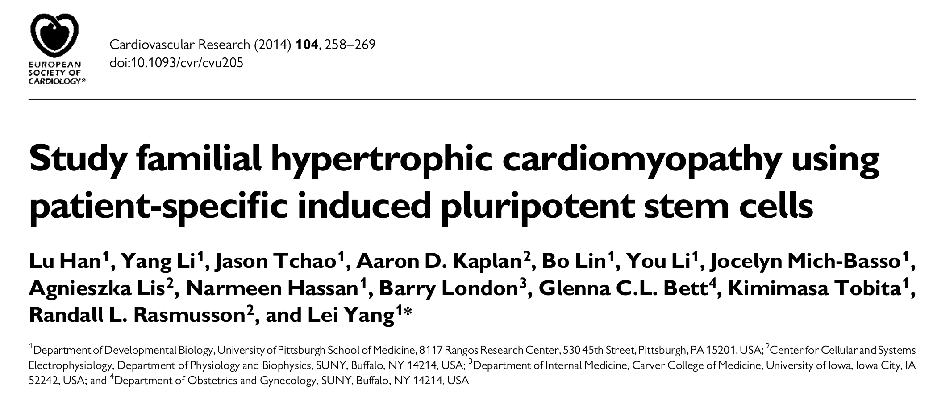
Lab Meeting Journal Club 12th of October

Slide 2
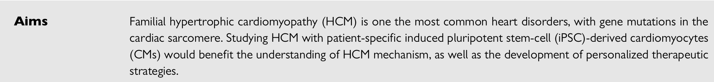

Slide 3
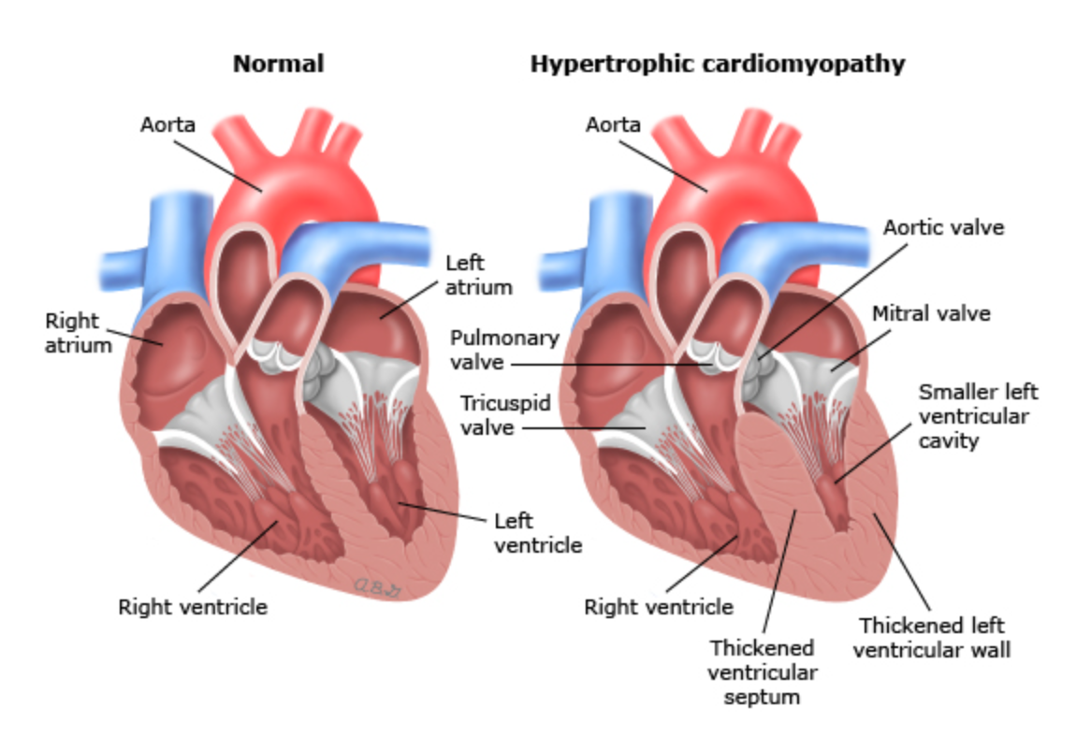
Hypertrophic Cardiomyopathy
Common symptoms:
Chest pain
Dyspnea
Dizziness and fainting
Fatigue
Complications:
Sudden cardiac death
Progressive heart failure
Systolic disfunction
Stroke

Slide 4
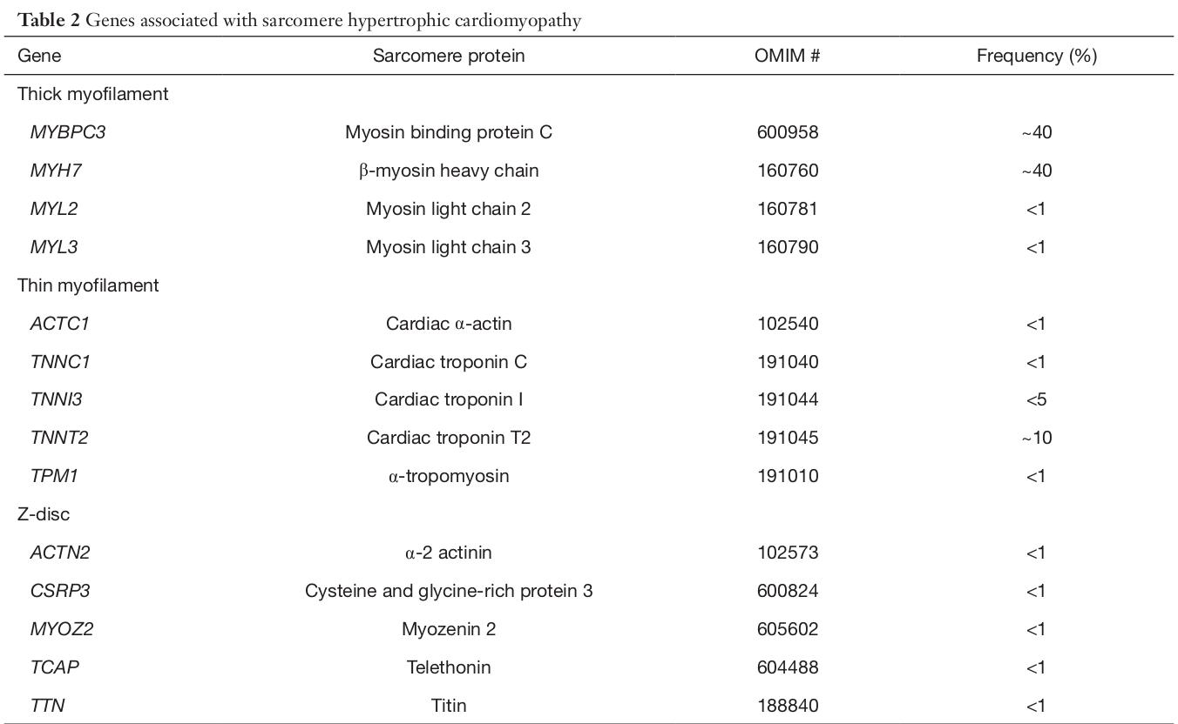
Genetic of HCM
C1324G mutation
Arginine to Glycine substitution at the
amino acid position 442 (R442G)
of MYH7 protein
Cordula Maria Wolf. Hypertrophic cardiomyopathy: genetics and clinical perspec tives.
Cardiovascular diagnosis and therapy, 9(Suppl 2):S388, 2019

Slide 5
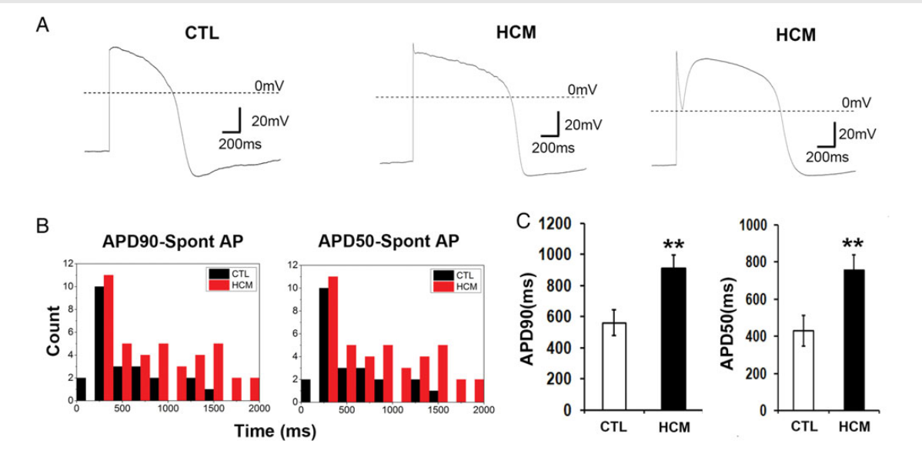
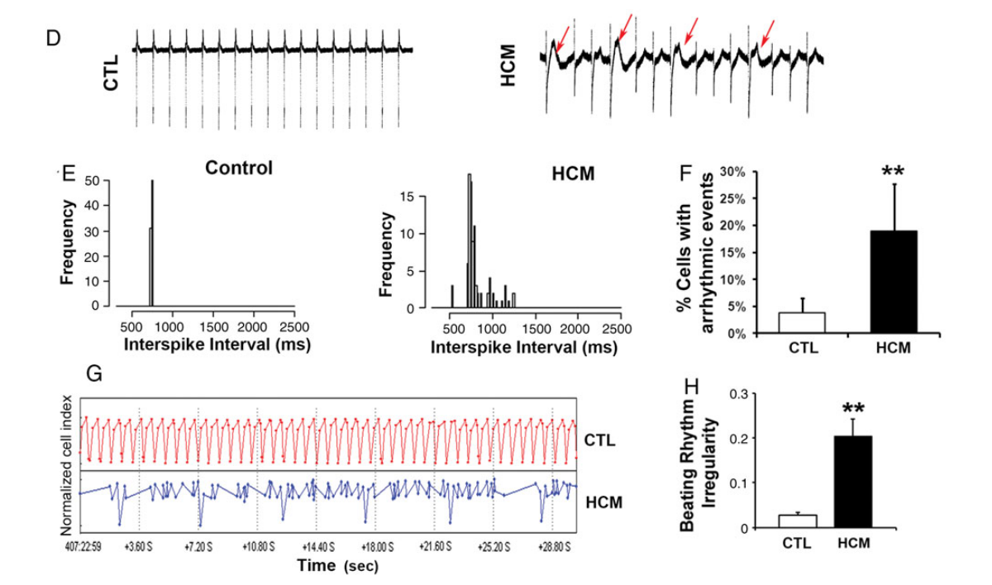
Electrophysiological analyses of HCM iPSC-CMs
Electrophysiological behaviour of single
HCM iPSC-CMs
Electrophysiological behaviour of CM
monolayers

Slide 6
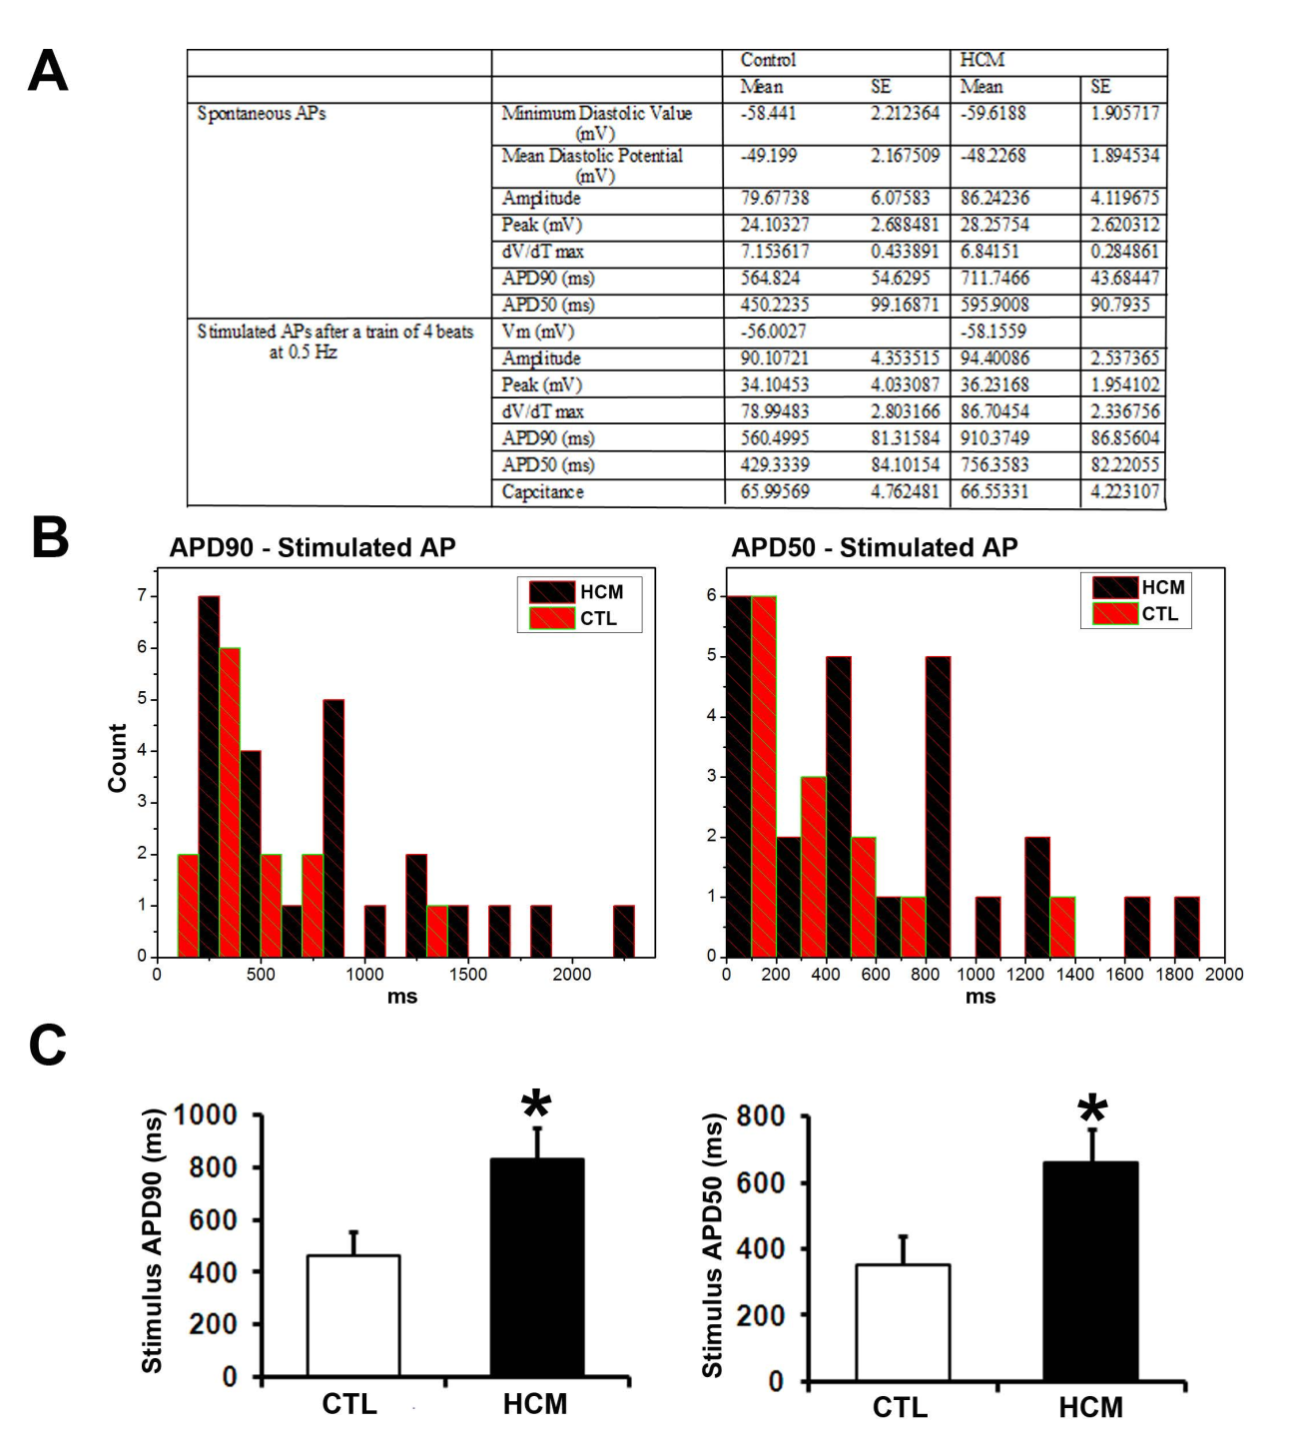
Characterization of action-potentials
Recording from the control and HCM
IPSC-derived single cardiomyocytes.

Slide 7
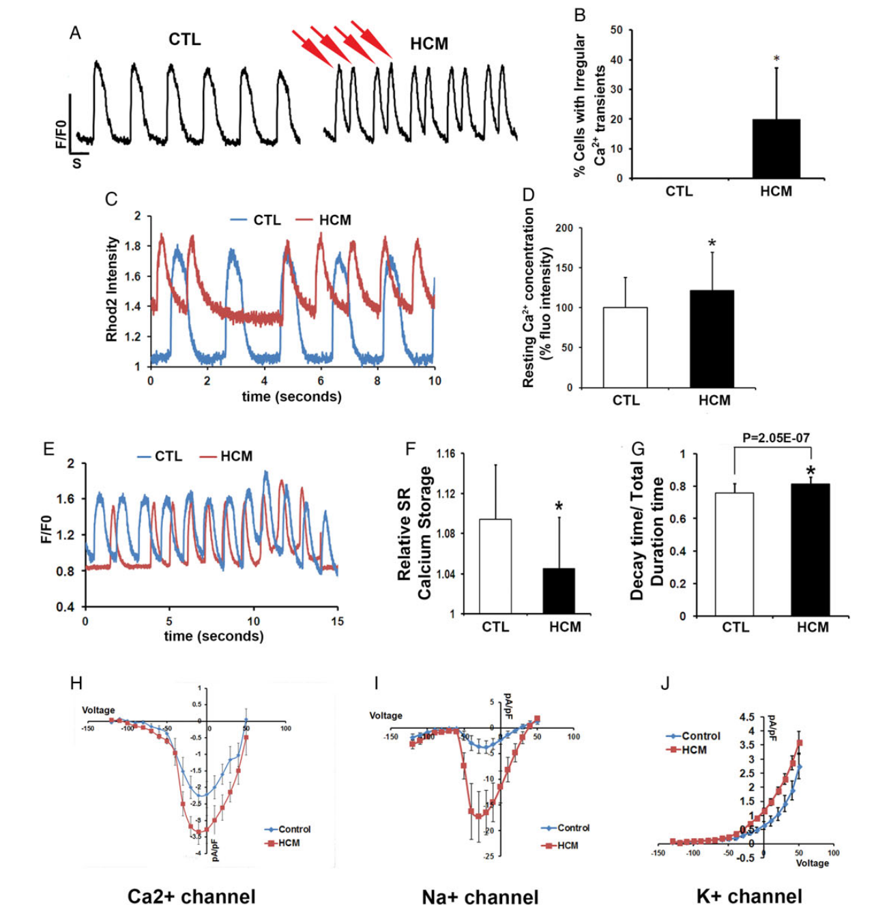
Calcium transient behaviour in HCM iPSC-CMs
Analysis of calcium handling
and ion channels

Slide 8
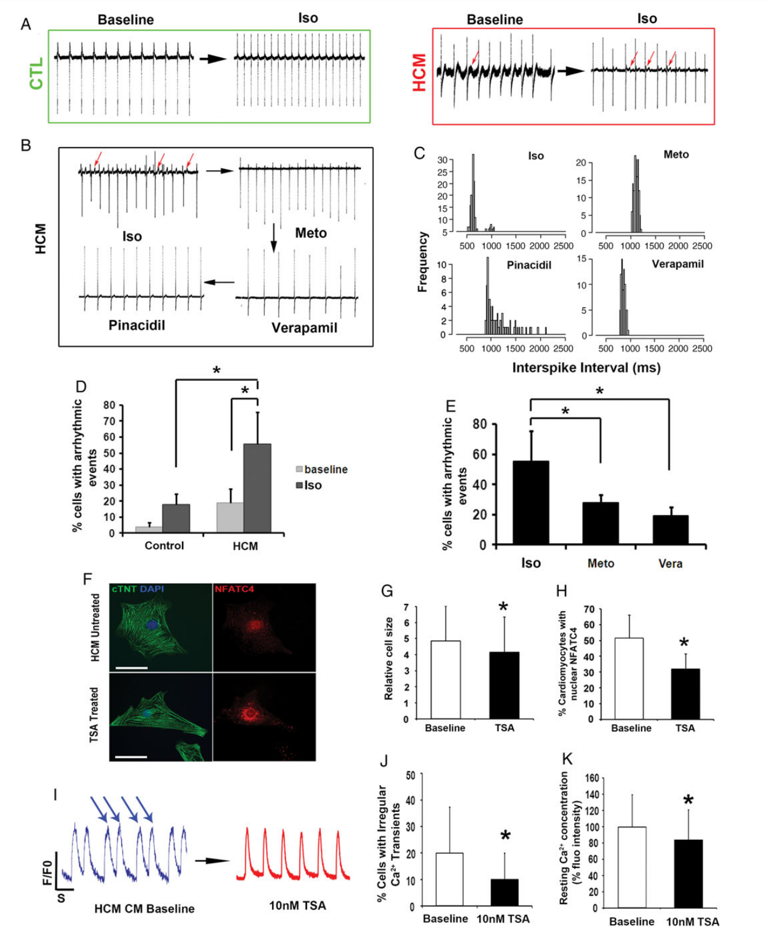
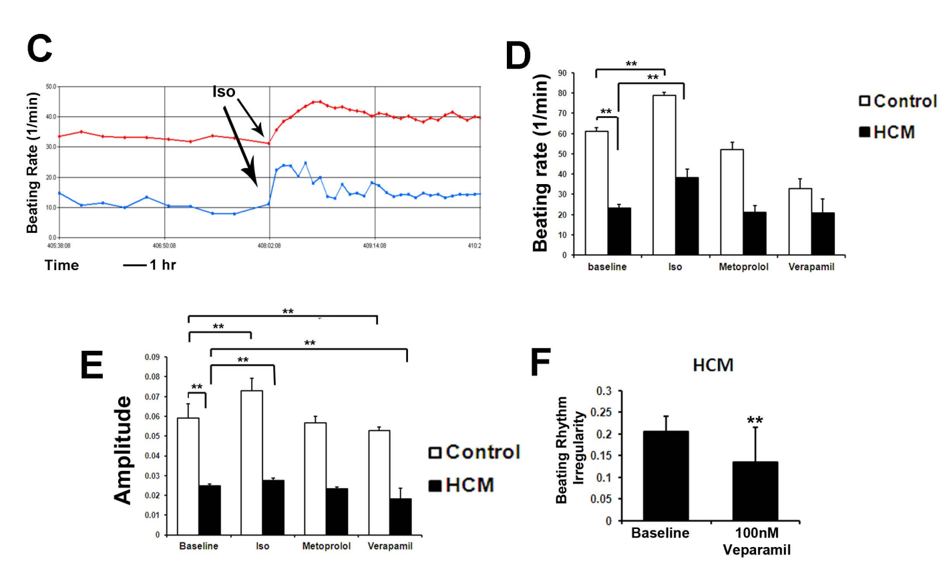
Pharmaceutical treatment of HCM iPSC-CMs
Recording of iPSC-derived
monolayer CMs
Iso: isoproterenol
Meto: metoprolol
TSA: Trichostatin A

Slide 9
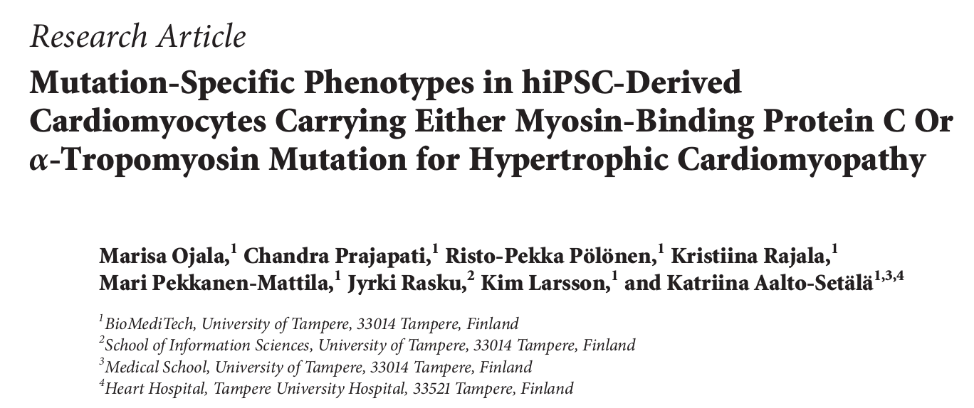

Slide 10
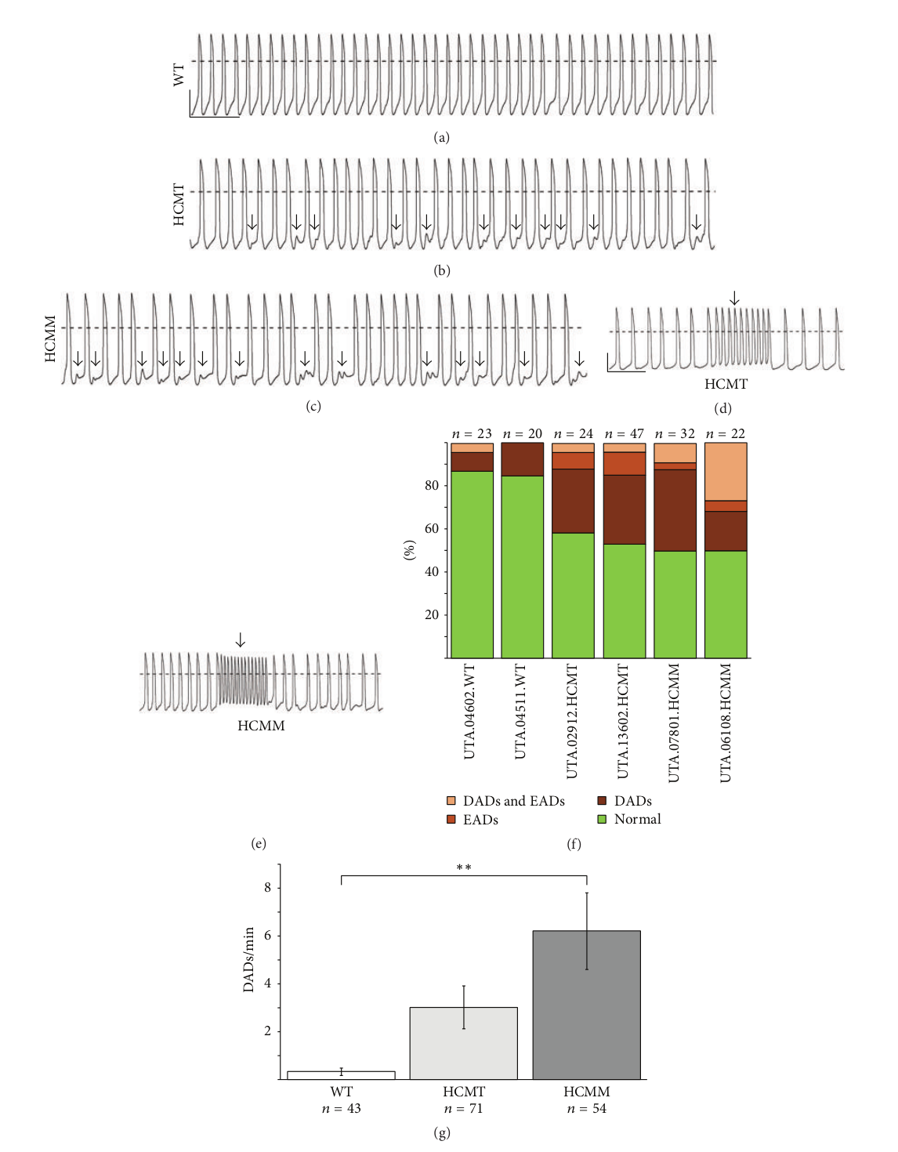
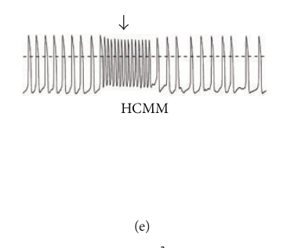
Action Potential Characteristics of WT and HCM hiPSC- Derived Cardiomyocytes

Slide 11


